Slide 1
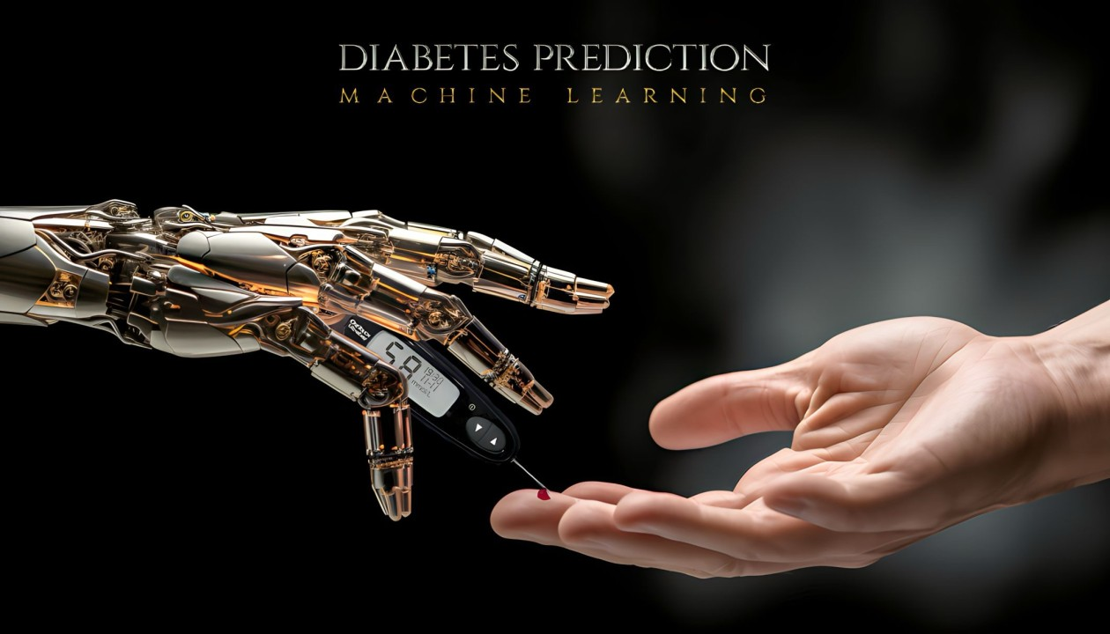
UT Austin Data Analytics and Visualization Bootcamp - Final Project
B A C K G R O U N D
Steven Miller, Nidhi Ojha, Luis Rivera, Beauty Simora, Preeti Wadhwa

Slide 2
01
02
03
Selected Topic
The Dataset
Data Exploration
Why Diabetes?
Kaggle
What does the data look like?
What features are there?
04
05
Analysis & Machine Learning
Conclusion
Are there any trends?
What insights can we draw from ML?
What conclusion can we draw?

Slide 3
“Diabetes is a great example whereby, giving the patient the tools, you can manage yourself very well.”
— Clayton M. CHRISTENSEN

Slide 4
Selected Topic
01
Why Diabetes?

Slide 5
WHAT IS DIABETES?
Diabetes is a persistent health condition characterized by its chronic nature, impacting the body's ability to convert food into energy effectively.
About 38 million US adults have diabetes.
20% don’t know they have it.
Eighth leading cause of death in the United States.
No. 1 cause of kidney failure, lower-limb amputations, and adult blindness.
The number of adults diagnosed with diabetes has more than doubled in the last 20 years.

Slide 6
WHAT REALLY IS LACKING IN THE BODY THAT CAUSES CAUSES DIABETES?
There is a lack of insulin production, or the body’s own cells stop responding to insulin
What happens to the excess glucose?
Loads of sugar circulating in the bloodstream with potentially harmful medical conditions/diseases such as:
Heart disease
Vision loss
Kidney disease
Source: https://www.cdc.gov/diabetes/basics/diabetes.html

Slide 7
OUR MOTIVATION
Diabetes is an increasingly growing health issue due to our inactive lifestyle.
If it is detected in time then through proper medical treatment, adverse effects can be prevented.
To help in early detection, technology can be used very reliably and efficiently.
Using machine learning we have built a predictive model that can predict whether the patient is diabetes positive or not.

Slide 8
The Dataset
02
www.kaggle.com

Slide 9
In this project, the objective is to predict a probability of being diabetic or non-diabetic based on various features like blood glucose levels, HBA1C levels, BMI etc. The project uses a diabetes prediction dataset from Kaggle. The code is divided in 9 parts that starts from data gathering to model deployment to testing the prediction hypothesis with test data via a frontend web page. This model can be useful for healthcare professionals in identifying patients who may be at risk of developing diabetes and in developing personalized treatment plans.
OUR OBJECTIVE

Slide 10
The Diabetes Prediction dataset is a collection of medical and demographic data from patients, along with their diabetes status (positive or negative). The data includes features such as:
OUR DATASET
AGE
GENDER
BMI
HEART DISEASE
BLOOD GLUCOSE LEVEL
SMOKING HISTORY
HYPER-TENSION
HBA1C LEVEL

Slide 11
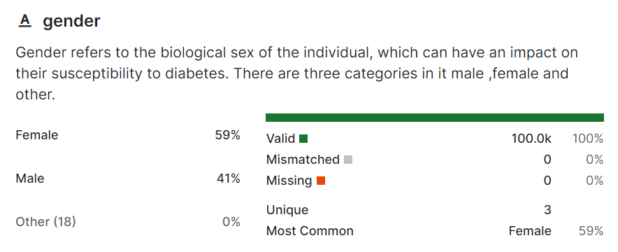
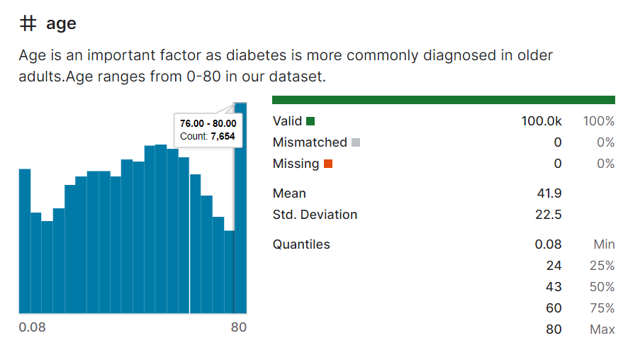
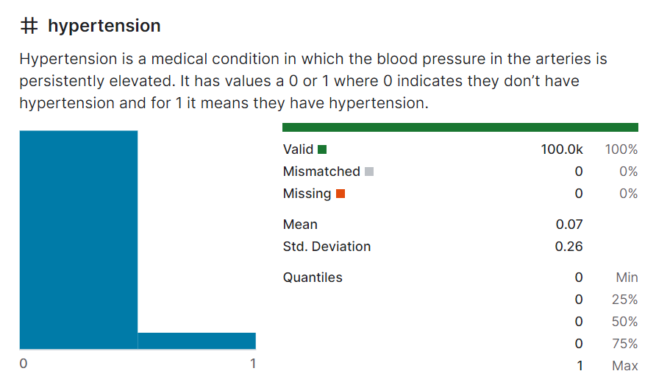
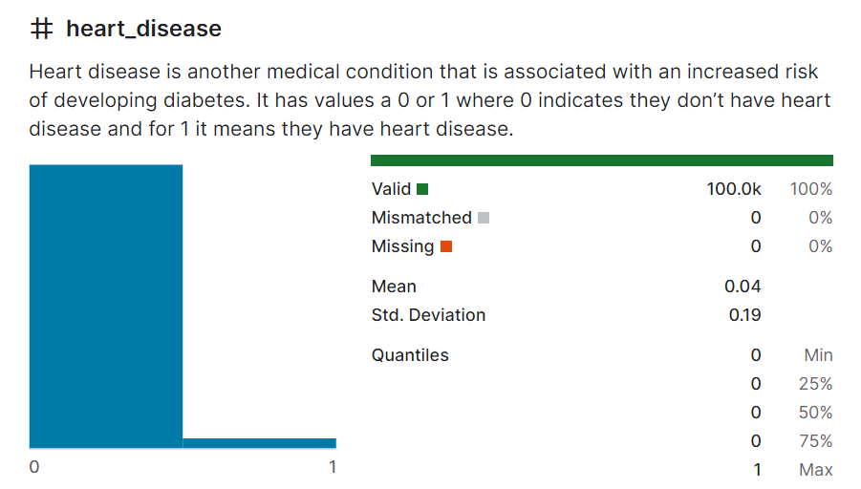
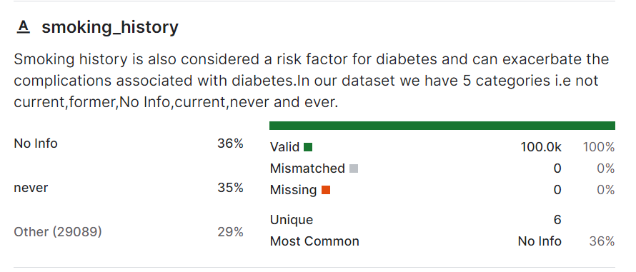
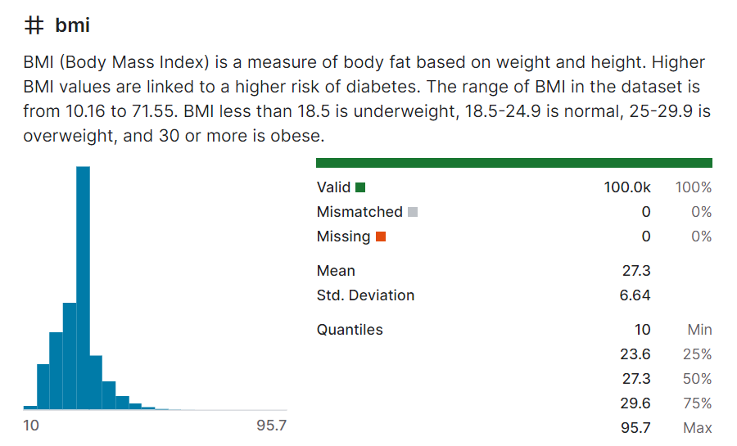
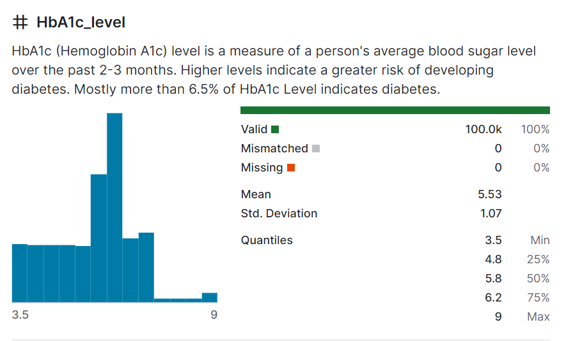
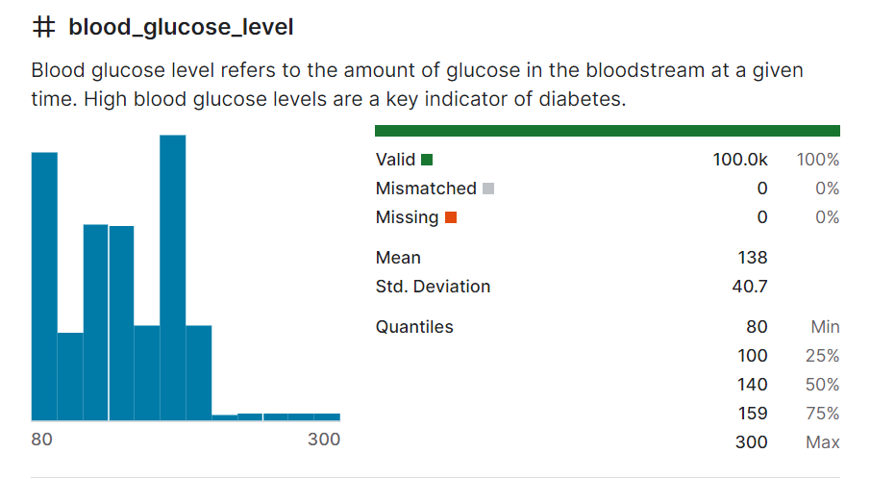
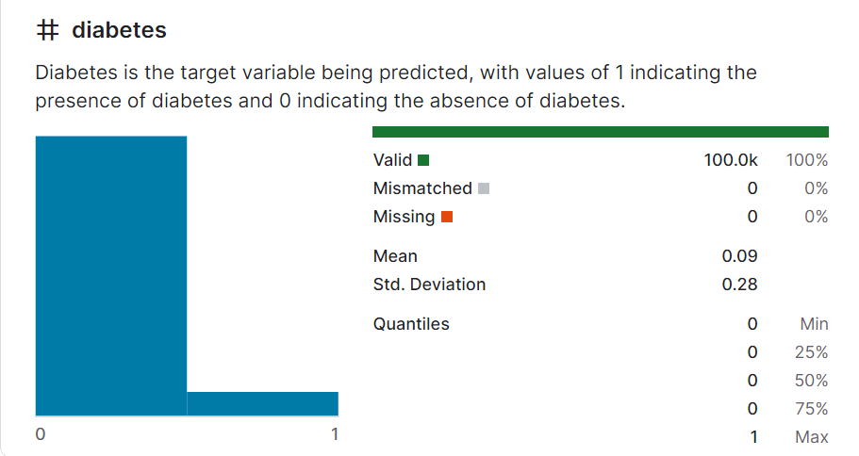
https://www.kaggle.com/datasets/iammustafatz/diabetes-prediction-dataset
OUR DATA SOURCE - KAGGLE

Slide 12
Data Exploration
03
What does the data look like?
What features are there?

Slide 13
Using tools such as Spark, and Python, we explored the data to find additional details : - Count of the number of rows - Study of the schema - Count of total number of diabetic and non-diabetic values. (Note: 1 - Presence of diabetes, 0 - Absence of diabetes) - Count of total number of gender types - Check for empty values in the gender column - Get summary statistics to describe the data frames count, mean, stddev, min and max
FEATURE ENGINEERING - DATA EXPLORATION

Slide 14
Cleaned and Prepared data - Check for null values - Get rid of the "Other" value in the gender column to limit it to Male and Female values - Remove the "No Info" value from the smoking_history column as that will not be useful data for our ML model - Assign 0 and 1 values in gender column where 0 means "Female" and 1 means "Male" - Assign numeric values to the smoking_history column where "never" = 0, "ever" = 1, "not current" = 2, "current" = 3, "former" = 4
FEATURE ENGINEERING – DATA CLEANING

Slide 15




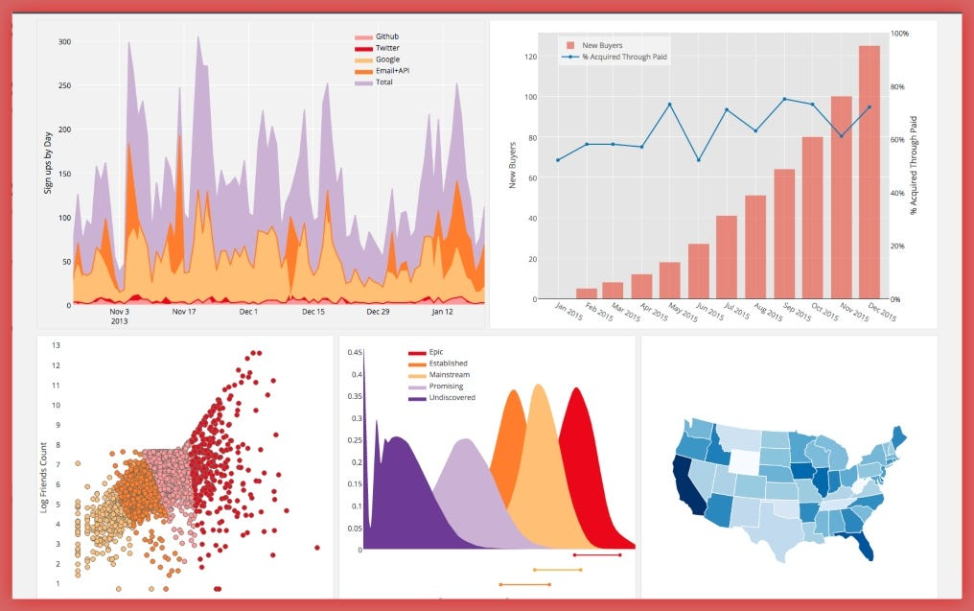


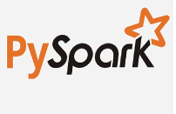

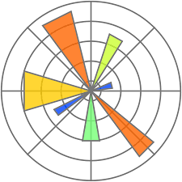
TECHNOLOGY STACK
Host API for Web UI
(Flask)
Raw Dataset
Data Wrangling
(pySpark, pandas)
Data Visualization
(matplotlib)
Train, Test, Save Model
(pySpark ML Lib)
Google Collab Hosted Environment

Slide 16
Analysis & Machine Learning
04
Are there any trends?
What insights can we draw from ML?

Slide 17

A PICTURE REINFORCES THE CONCEPT
xxx

Slide 18
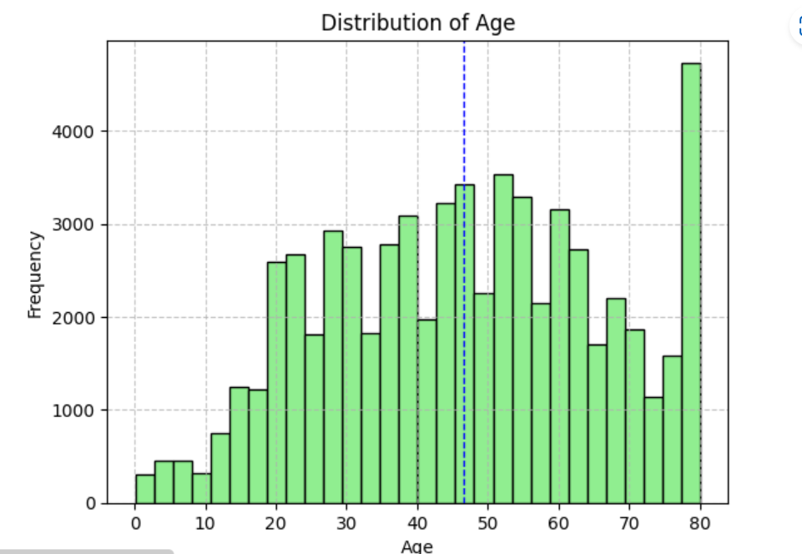
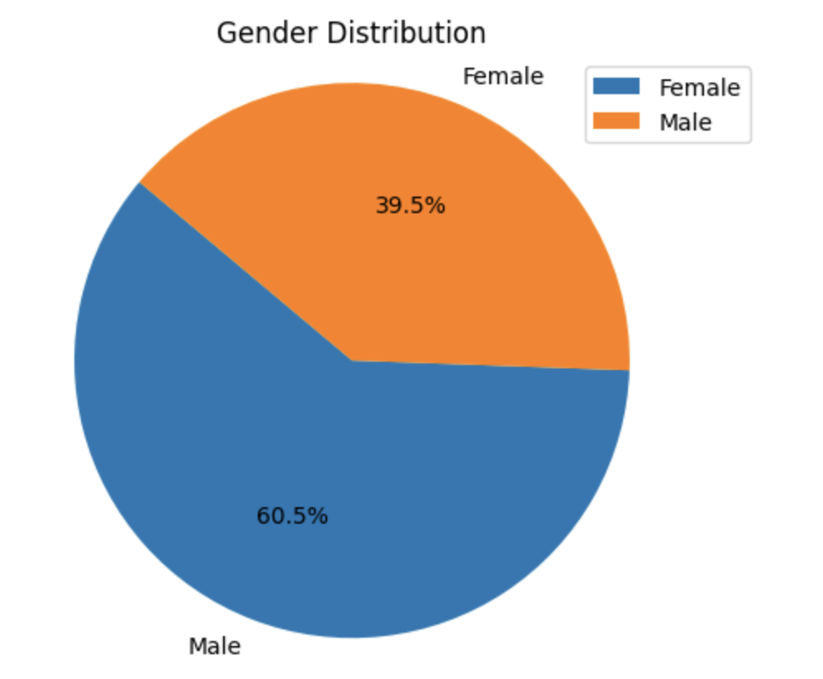
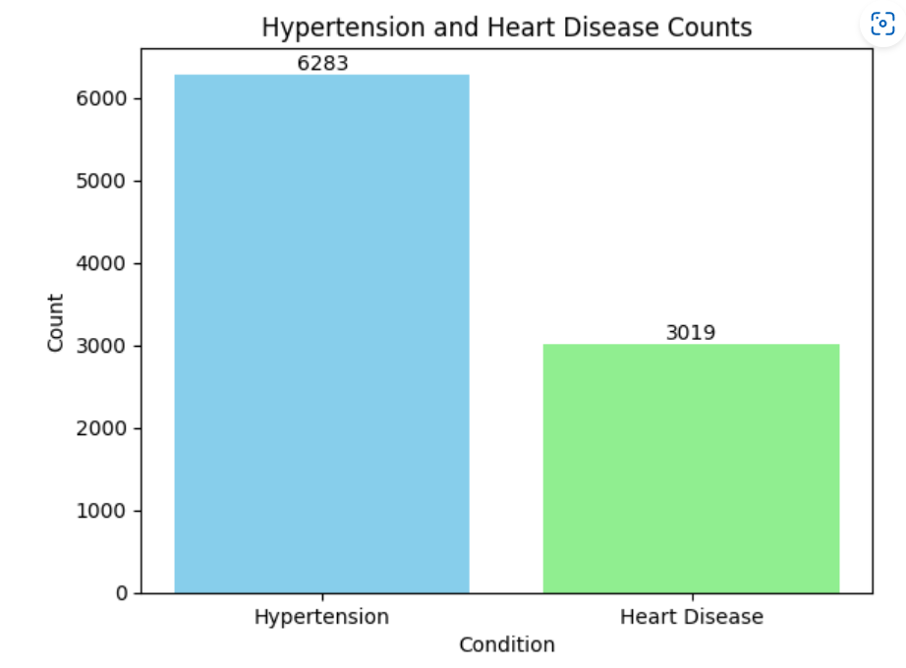
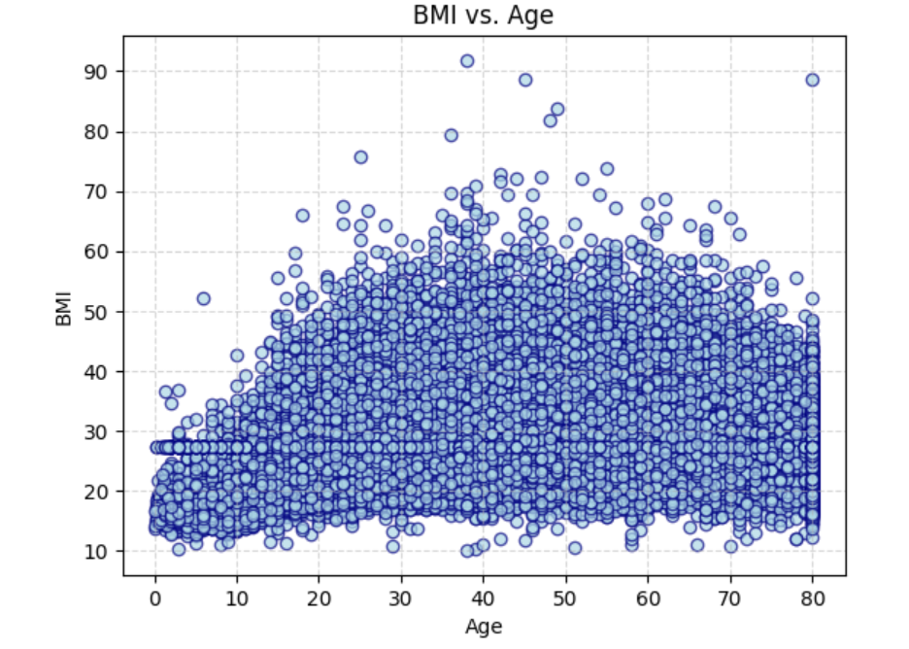
DATA VISUALIZATION

Slide 19
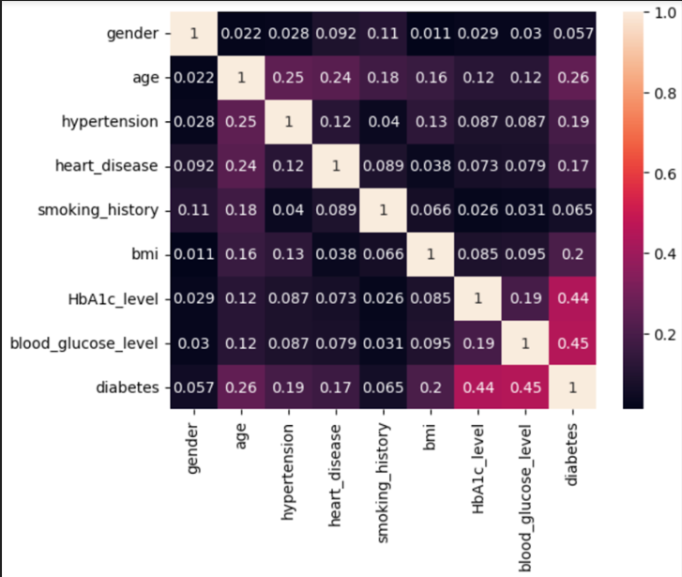
HEAT MAP
DATA VISUALIZATION

Slide 20
DATA OBSERVATIONS
- Dataset used has a balance age distribution representing each decade of human age
- Dataset has a greater number of non-diabetic records than diabetic indicating imbalance nature
- Dataset has 60% female representation as opposed to 40% male
- Dataset has good representation of all possible BMI
- Dataset has sufficient representation of people with Hypertension or Heart Disease
- Dataset visualization using Boxplot and Correlation Heatmap indicates clearly that high Hb1Ac & Blood Glucose level is fairly correlated with the outcome

Slide 21
DEMO

Slide 22
BUILD OUT OF THE ML MODEL
- Evaluate the correlation analysis and select the feature
- Find the correlation among the input and output variables
- Select the Feature with the help of VectorAssembler from pyspark.ml.feature library
- Create final data using LogisticRegression model from pyspark.ml.classification library
- Split the dataset and build the model. 70% used for training and 30% for testing
- Evaluate the model predictions using BinaryClassificationEvaluator from pyspark.ml.evaluation library
- Model efficiency comes out to be 95.84%

Slide 23
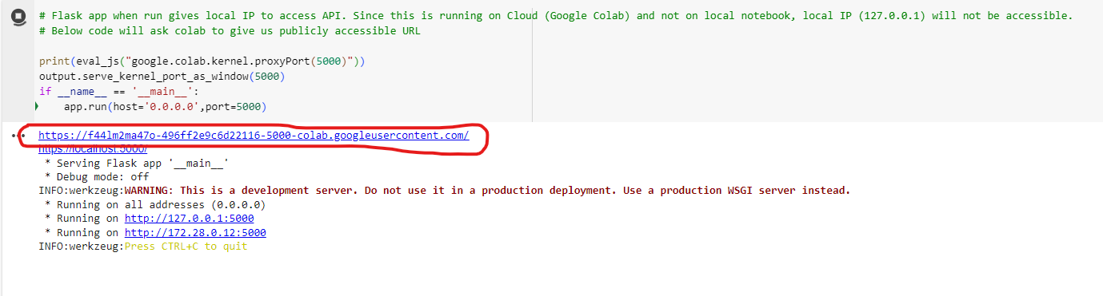
FLASK API
API ON GOOGLE COLLAB

Slide 24
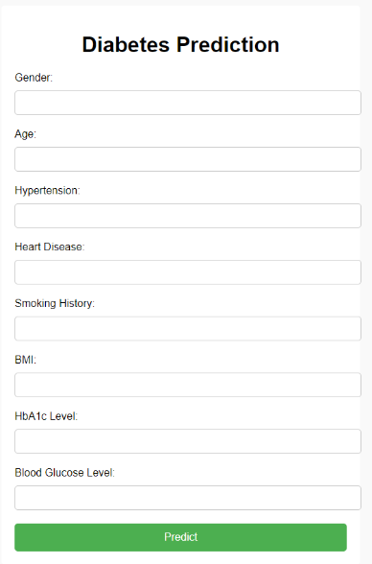
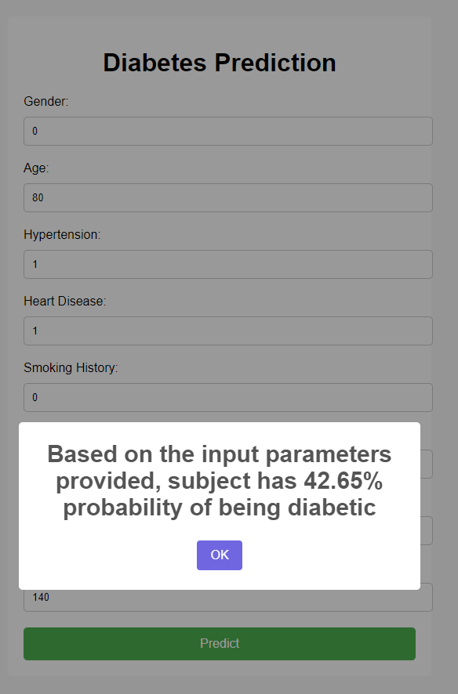
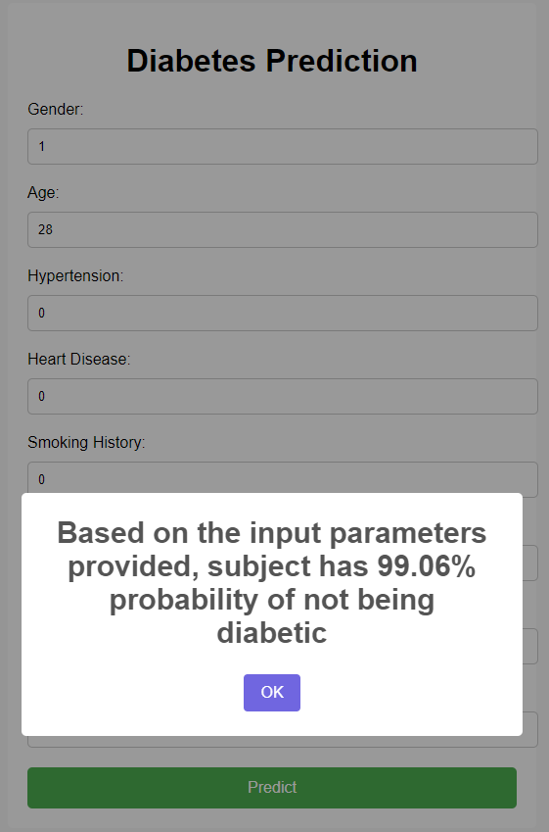
DIABETES PREDICTION
WEB UI
DIABETIC USE CASE
NON-DIABETIC

Slide 25
Conclusion
05
What conclusion can we draw?

Slide 26
The development and evaluation of our diabetes prediction model has yielded promising results. Leveraging a combination of demographic and health-related features our binary classification regression model has demonstrated high efficiency in accurately predicting the probability of individuals having or not having diabetes. With an impressive efficiency rate of 95.84% on data, our model showcases its robustness and reliability in distinguishing between diabetic and non-diabetic individuals.
RESULTS ANALYSIS

Slide 27
This achievement underscores the potential of machine learning algorithms in healthcare, particularly in the realm of disease prediction and early intervention. The implications of such a model extend beyond mere prediction; it can serve as a valuable tool for healthcare practitioners in identifying high-risk individuals, facilitating proactive interventions, and ultimately improving patient outcomes. Additionally, it can aid in resource allocation and healthcare planning by targeting preventive measures towards those most likely to develop diabetes.
FUTURE ENHANCEMENTS

Slide 28
In conclusion, our diabetes prediction model represents a significant step towards personalized medicine and preventive healthcare. By harnessing the power of machine learning and comprehensive health data, we aim to empower both individuals and healthcare providers in the proactive management of diabetes and its associated risks, ultimately contributing to improved health outcomes and quality of life for all. A similar model can be built for a variety of diseases like breast cancer, Dementia, etc. in much detail and can be highly reliable once it gets high enough accuracy.
CONCLUSION & FURTHER APPLICATION

Slide 29
THANKS!
Do you have any questions?

